Slide 1
Data, Environment and Society Lecture 6: Exploratory Data Analysis and Data Cleaning and Energy and Development
September 11, 2018
Instructor: Duncan Calllaway
GSI: Seigi Karasaki

Slide 2
Announcements
Reminders
Late policy
Lab 3 due Friday, HW3 due next Tuesday.
HW3 is long – longer than most will be.
Reading
Today:
Goldemberg et al
We will be using material from DS100 Ch4 and 5
Thursday: DS100 Ch6 textbook (visualization)
Next Tuesday: Lee et al 2016. See README.md for questions to focus on.
Next Tuesday: Josh Apte, UT Austin, will talk about his work on the health impacts of PM2.5.

Slide 3
Data cleaning
Do you see missing values?
Are there cells where missing values were obviously filled in?
Are there cells where values are clearly wrong?
Are there values where two entries could mean the same thing? Often human-entered values, e.g.:
canine and k9;
recommend and recommend,
Zürich and Zurich etc

Slide 4
Data merging
How many rows and columns do you have when you start?
How many do you have after the merge?
What’s missing? Is it acceptable to you if you’ve lost some data?
We’ll return to this when we talk about faithfulness and scope.
I wrote a script for the class to use in the upcoming homework that helps decipher what data gets lost.

Slide 5
Exploratory Data Analysis (EDA)
One can approach EDA by asking questions about the data:
Structure
Granularity
Scope
Temporality
Faithfulness

Slide 6
Structure
Are the data in a standard format or encoding?
Tabular data: CSV, TSV, Excel, SQL
Nested data: JSON, XML
Are the data organized in records (e.g. rows)? If not, can we define records by parsing the data?
Are the data nested? If so, can we reasonably unnest the data?
Do the data reference other data? If so, can we join the data?
What are the fields (e.g. columns) in each record? What is the type of each column?

Slide 7
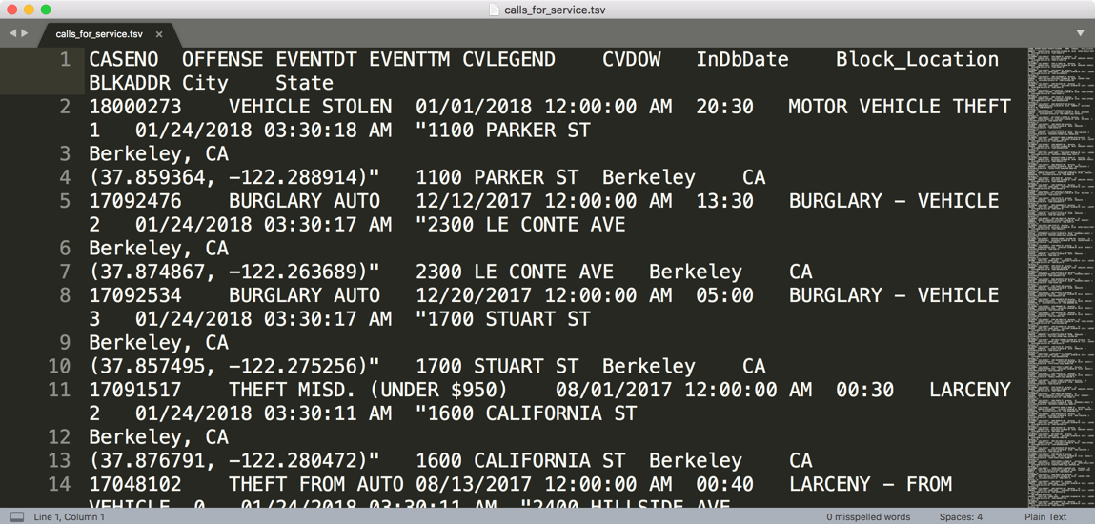
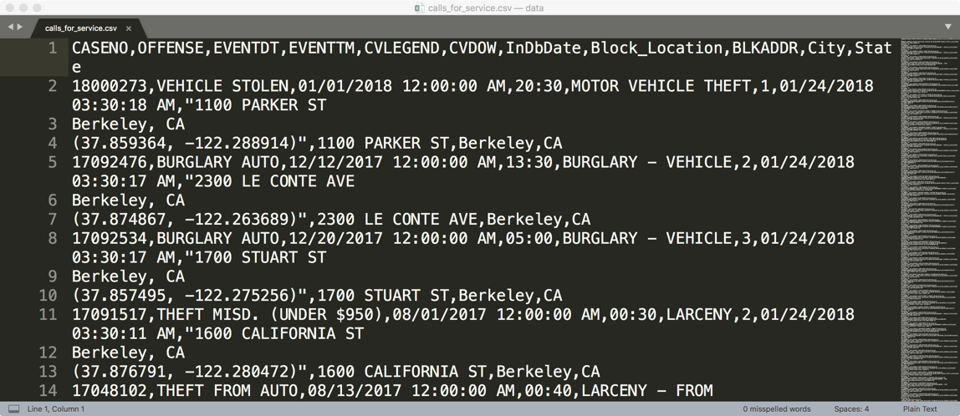
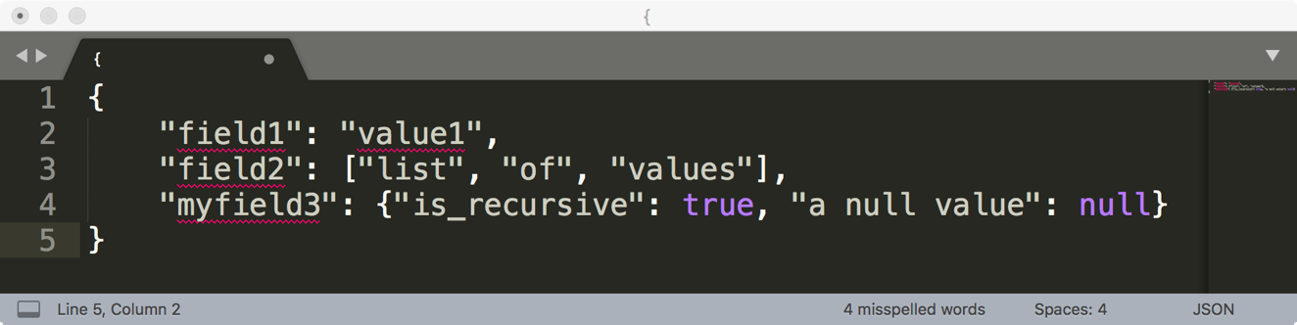
How are these data files formatted?
TSV
Tab separated values
Which is the best?
CSV
Comma separated values
JSON

Slide 8
Comma and Tab Separated Values Files
Tabular data where
records are delimited by a newline: “\n”, “\r\n”
Fields are delimited by ‘,’ (comma) or ‘\t’ (tab)
Very Common!
Main issue?
Some things that are part of the record get interpreted as delimiters: Commas, tabs, quotation marks

Slide 9
JavaScript Object Notation (JSON)
Squiggly brackets act as 'containers’
Square brackets holds arrays
Names and values are separated by a colon.
Array elements are separated by commas

Slide 10
JavaScript Object Notation (JSON)
Widely used file format for nested data
Natural maps to python dictionaries (many tools for loading)
Strict formatting ”quoting” addresses some issues in CSV/TSV
Issues
Each record can have different fields
Nesting means records can contain records → complicated
Side note: look at the “raw” form of the .ipynb files! (They’re JSON.)

Slide 11
Granularity
What does each record represent?
a purchase, a person, a group of users?
A home, a city, a country?
A minute, an hour, a year?
Do all records capture granularity at the same level?
Data sometimes includes summaries as records
If the data are coarse how was it aggregated?
Sampling, averaging, summing…
What additional kinds of aggregation is possible/desirable?
From individual people to demographic groups?
From individual events to totals across time or regions?
Hierarchies (city/county/state, second/minute/hour/days)

Slide 12
Scope
Does the data cover the topic of interest?
Subset of a population?
Specific range in time
Specific location
How complete are the data?
Are countries missing?
Are periods of time missing?

Slide 13
Temporality
What is the meaning of the date and time fields in the dataset?
Beware of time zones, daylight savings!
What representation do the date and time fields have in the data?
Are there strange timestamps that might represent null values?

Slide 14
Faithfulness
Unrealistic or incorrect values
Violations of obvious dependencies
E.g. age and birthday for individuals don’t match
E.g. sorting by record ID gives different result than sorting by time in PurpleAir data
Hand-entered data?
Spelling errors, etc.
Clear signs of falsified data
E.g. repeated names, fake looking email addresses, or repeated use of uncommon names or fields.

Slide 15
Summary: How do you “do” EDA?
Examine data and meta-data:
What is the date, size, organization, and structure of the data?
Examine each field/attribute/dimension individually
Examine pairs of related dimensions
Stratifying earlier analysis: break down grades by major …
Along the way:
Visualize/summarize the data (next time!)
Test your assumptions about the data, for example
“The range should be…”
“Sudden changes should not occur...”
Identify anomalies and either change update your assumptions or modify the data.
Record everything you do! (why?)

Slide 16
Reading: Goldemberg et al

Slide 17
Warmup questions to discuss
Summarize your take on the paper: What’s it about, what did you learn?
What details about global living conditions and income would we miss if we use GNP per capita data at the country level?
How does the Lorenz curve relate to the national dialog the U.S. had over the 99% vs. the 1% several years ago?
Figure 3.5 shows factors that describe living conditions in a country versus energy use.
What is “TOE" on the x-axis on these plots?
What trends do the plots in Fig 3.5 describe?
What kinds of conclusions can you make from this plot? What is your take on the ``1 TOE barrier``?

Slide 18
Quotes to discuss
“A low energy consumption is not, of course, the only cause of poverty and underdevelopment but it is a good proxy for many of its causes, such as poor education, bad health care and the hardship imposed on women and children.”
“Energy, in itself, is of little interest but it is an essential ingredient of socio- economic development and economic growth. The objective of the energy system is to provide energy services, for instance lighting, comfortable indoor temperature, refrigerated storage, transportation and appropriate temperatures for cooking.” "This meant that there could be a 'delinking' between GDP growth and energy growth, which did in fact take place in the industrialized countries in the 1970s and 1980s”
Notes:
Quote one points
“is a good proxy”.
What evidence do we have to support this statement? Couldn’t the causality go the other direction?
There certainly are mechanisms we can point to – education easier with lighting, health care easier with refrigerated vaccines, energy gathering easier w electricity. But could the conditions in some places be inhospitable to the positive impacts we envision? What if people prefer to cook with wood? What if they don’t like the light color from the leds? What if they believe vaccines cause autism?
What do these quotes mean and what do they imply for using energy use as a proxy?
In wealthy economies energy consumption has gone down, or at least per capita gdp has gone up while consumption remained flat. What does that imply?

